Slide 1
Probabilistic Record Linkage

Slide 2
Overview
9:00 - 9:30 Intro (1 question about record linkage)
9:30 – 10:00 Lecture (Probabilistic matching)
10:00 - 10:30 Break
10:30 – 11:00 Lecture (Evaluation)
11:00 - 11:30 Class activity: Match
11:30 – 12:00 Report back
12:00 – 1:00 Lunch
1:00 – 2:00 Notebook: Edit distance, fuzzy matching
2:00 – 3:00 Notebook: Pulling data from the API
3:00 - 3:30 Break
3:30 - 4:30 Class activity: additional fields in the API
4:30 - 5:00 Report back

Slide 3

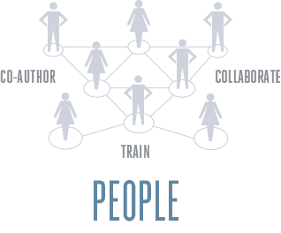

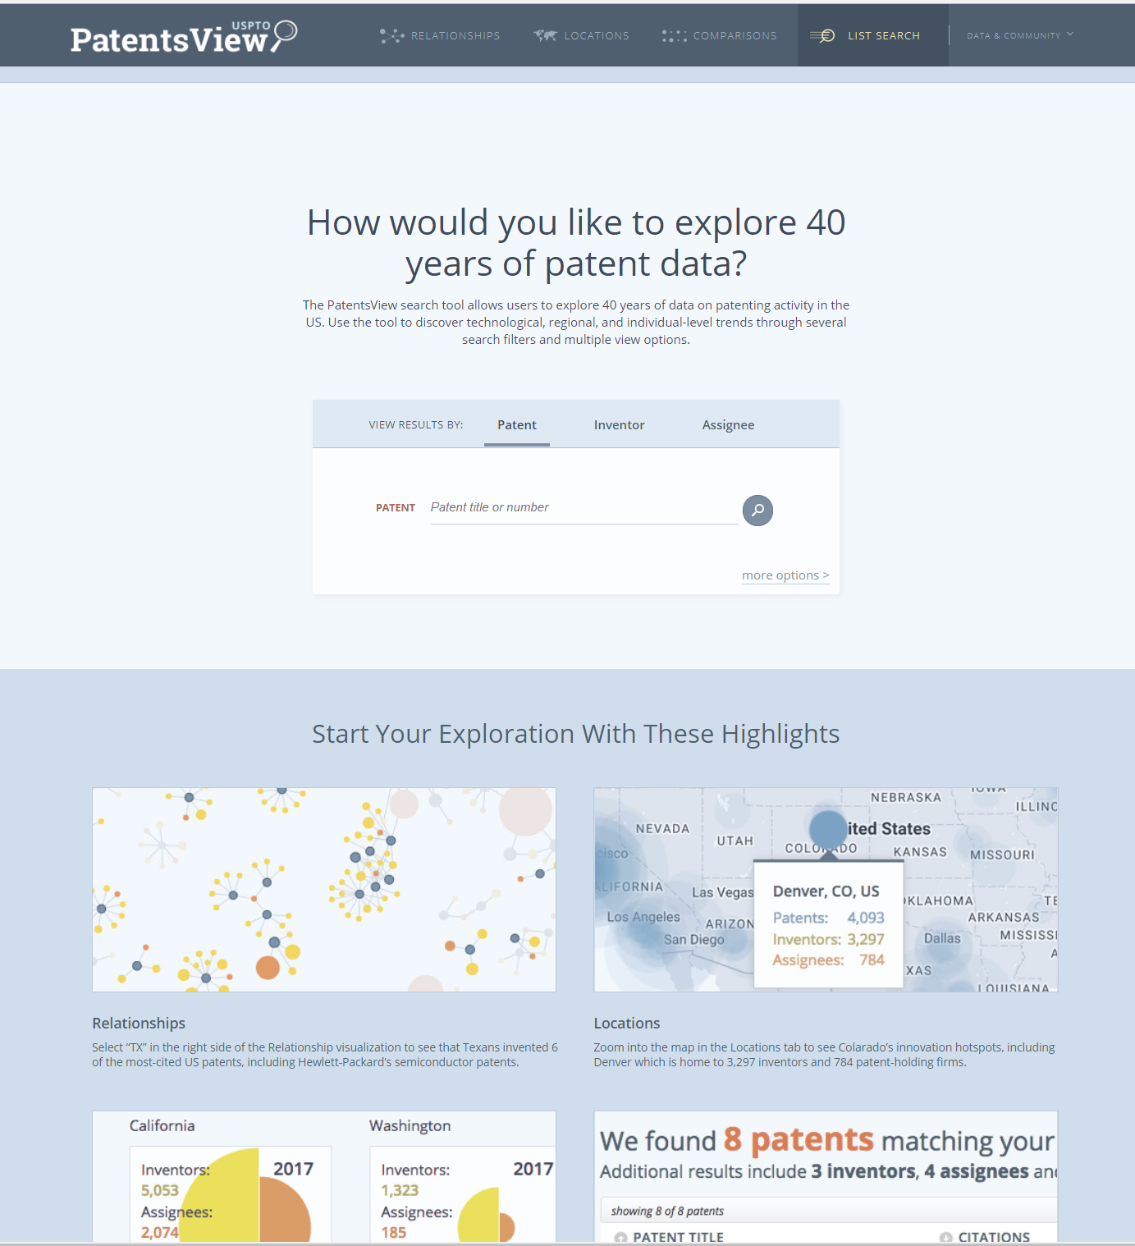

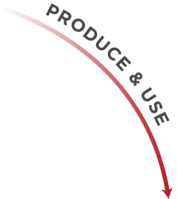



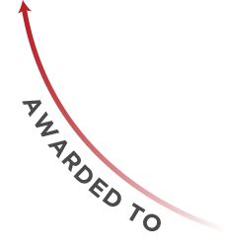
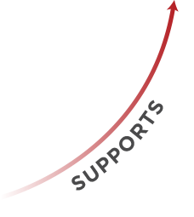
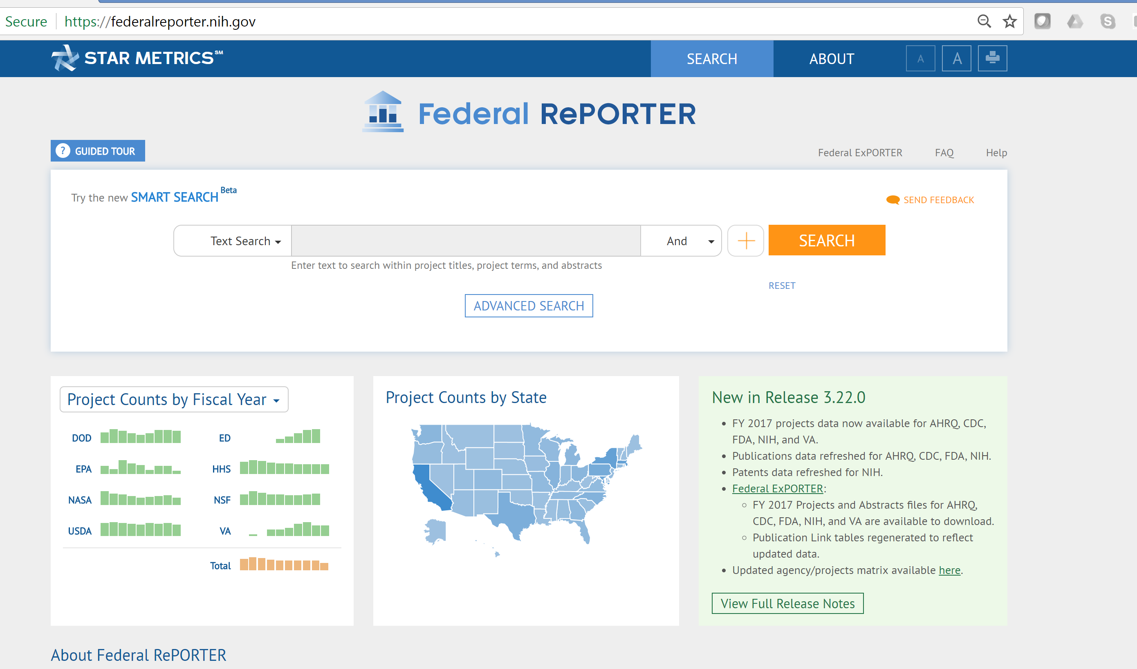
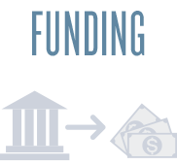
Why we care

Slide 4
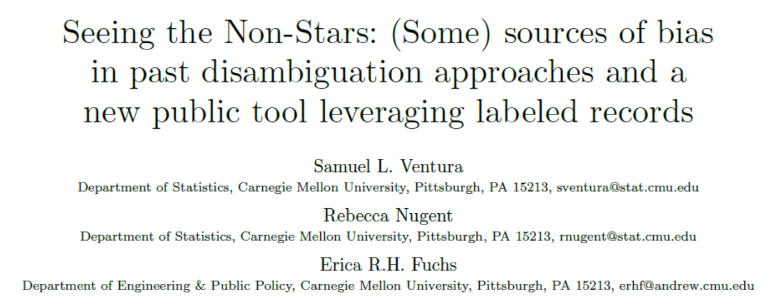

Slide 5
Match questions
Identify the 5 top grant receiving universities in 2010. How many grants?
Identify the 5 top patenting organizations in 2018. How many patents?
Identify the 5 top PIs in 2010. How many grants?
Identify the 5 top inventors in 2018. How many patents?

Slide 6
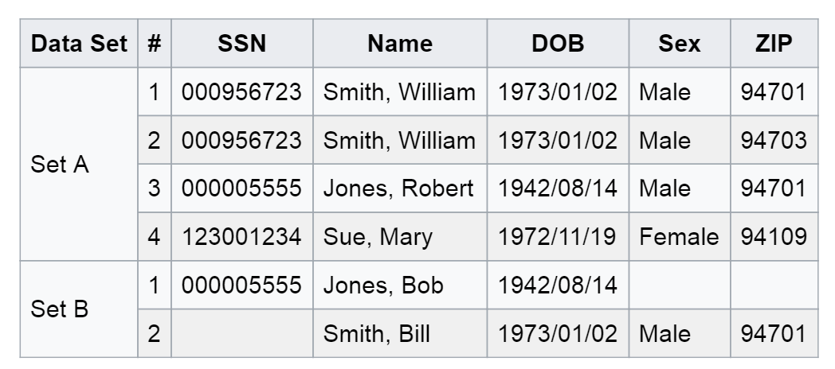
Deterministic (rule based) linkage
simplest method of matching
sort/merge exact match
works best with single unique identifier (key)
Identifiers
have equal weight
chosen by researcher or availability
Works well if keys are perfect and present in all datasets you want to link. In Example one key not enough (missing data), next key (name) has errors in it
Example: https://en.wikipedia.org/wiki/Record_linkage

Slide 7
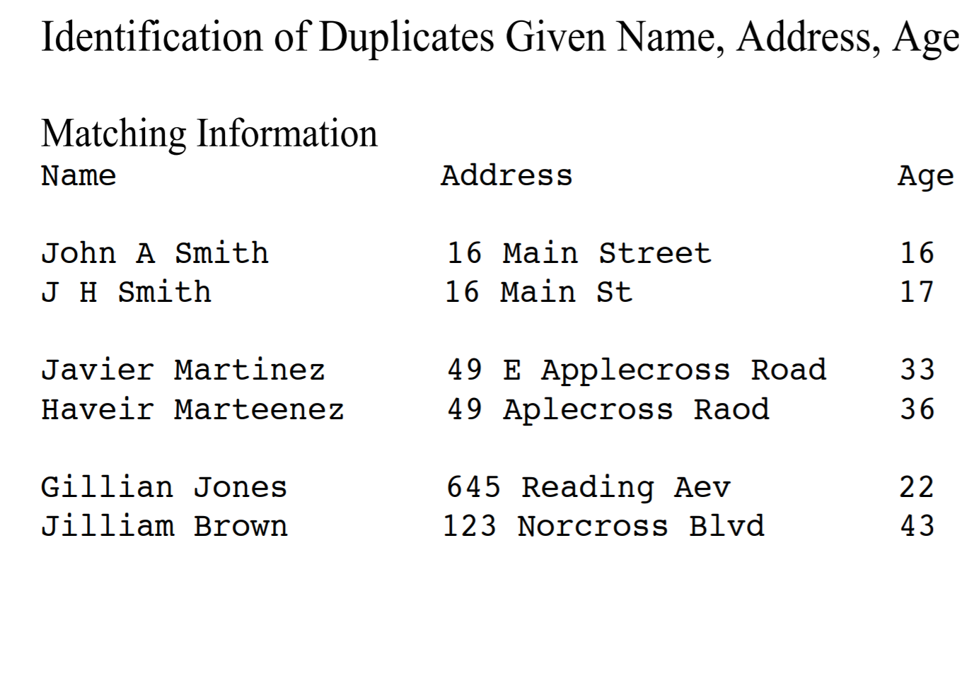
Canonical Problem

Slide 8
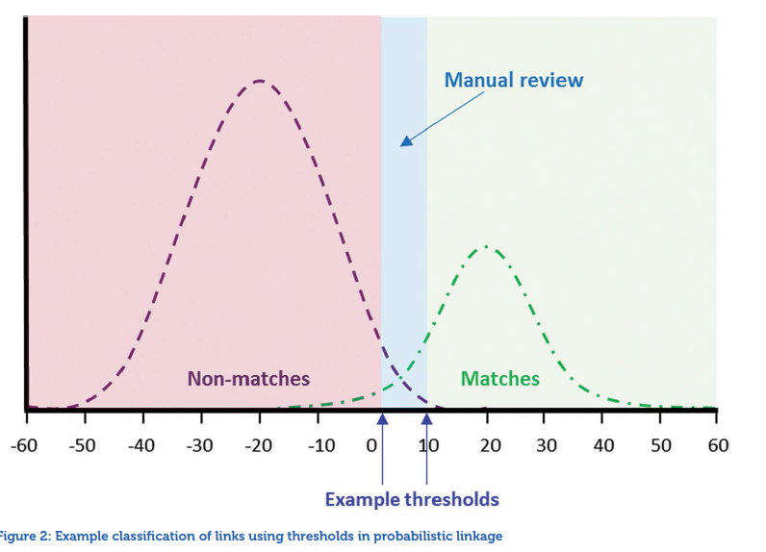
Probabilistic Record Linkage
Source: ADRN : Introduction to Record Linkage

Slide 9
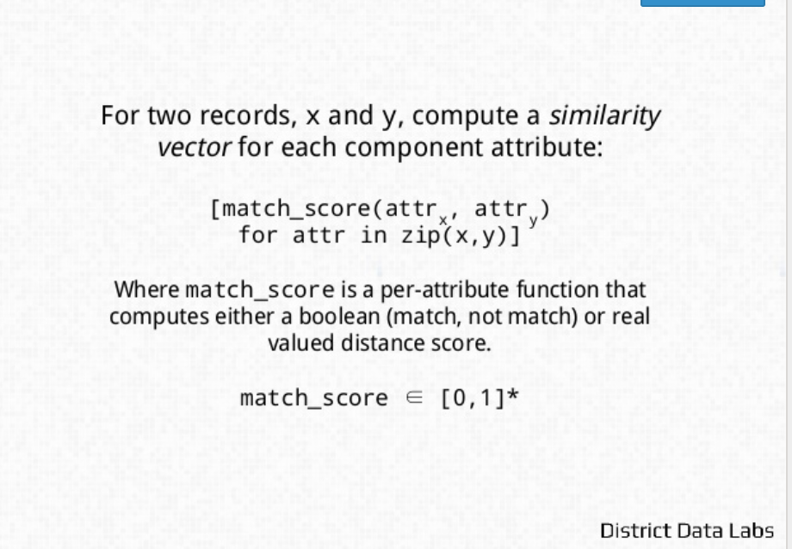
Core issue: Compute similarity

Slide 10
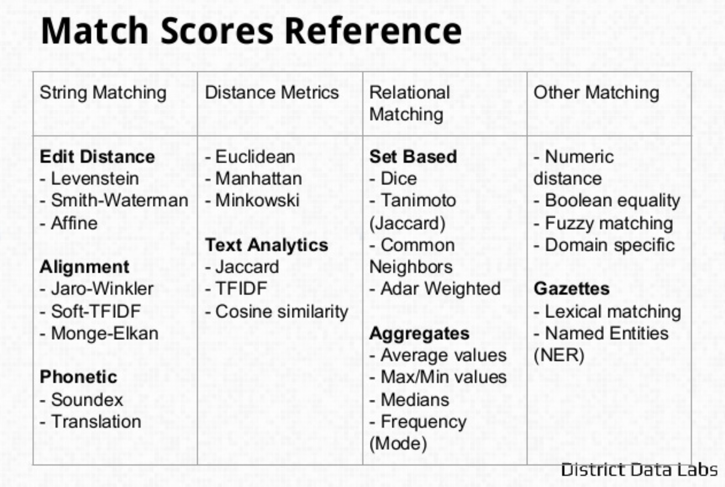
Conceptual Framework

Slide 11
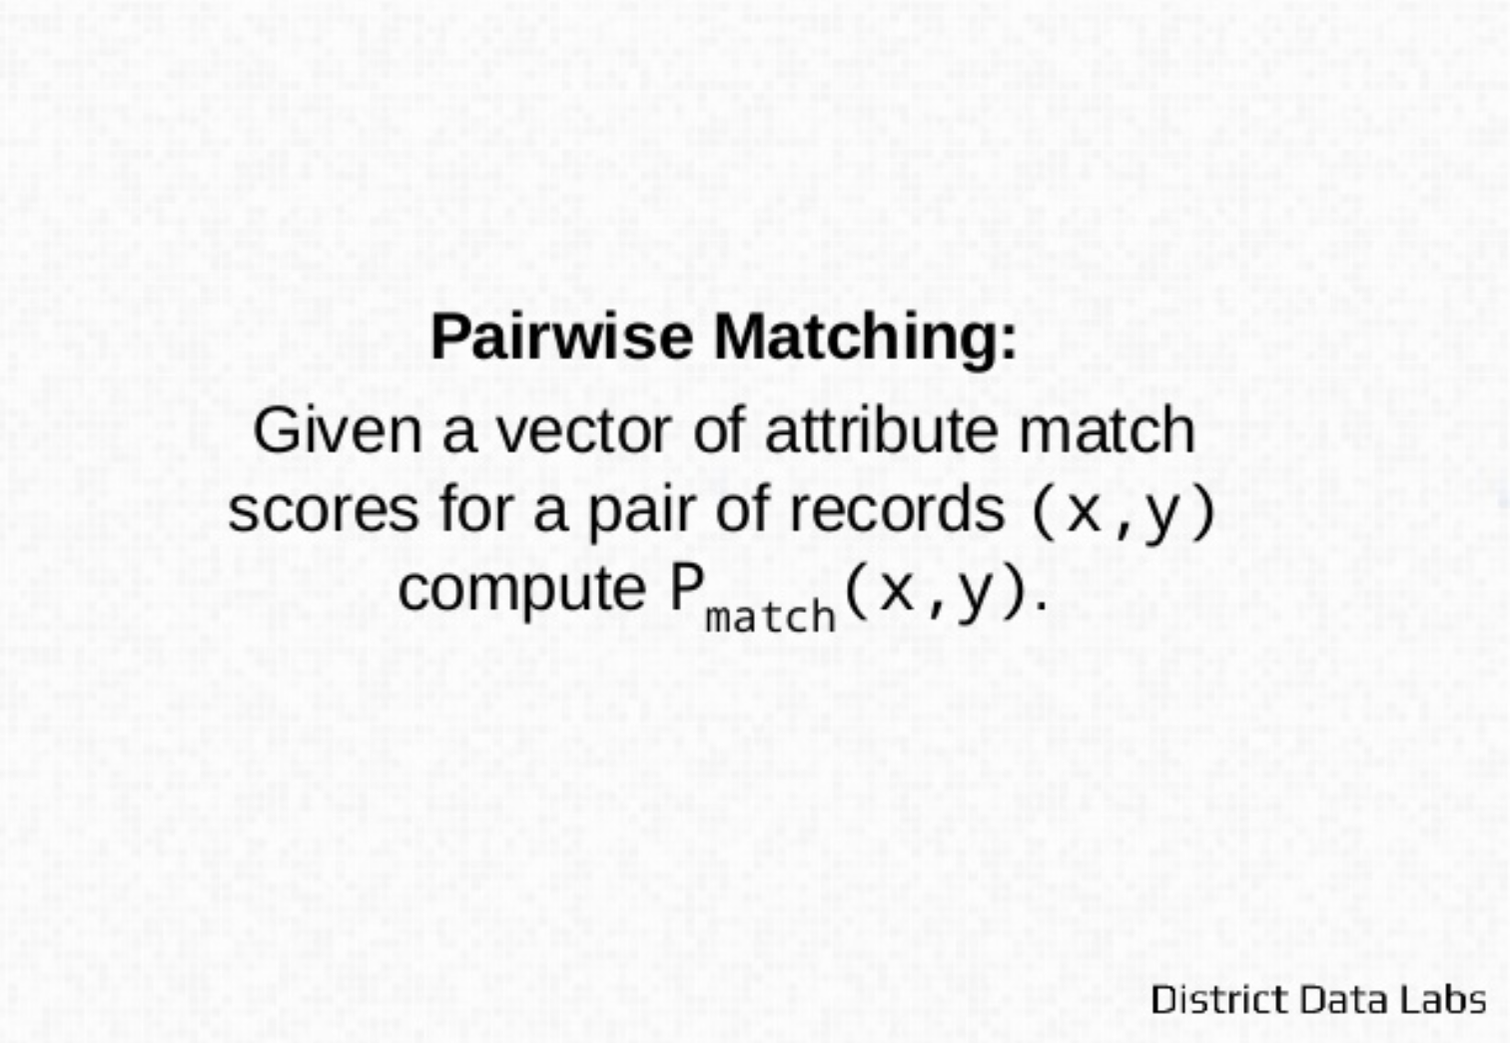
Felligi Sunter
https://www.slideshare.net/BenjaminBengfort/a-primer-on-entity-resolution

Slide 12
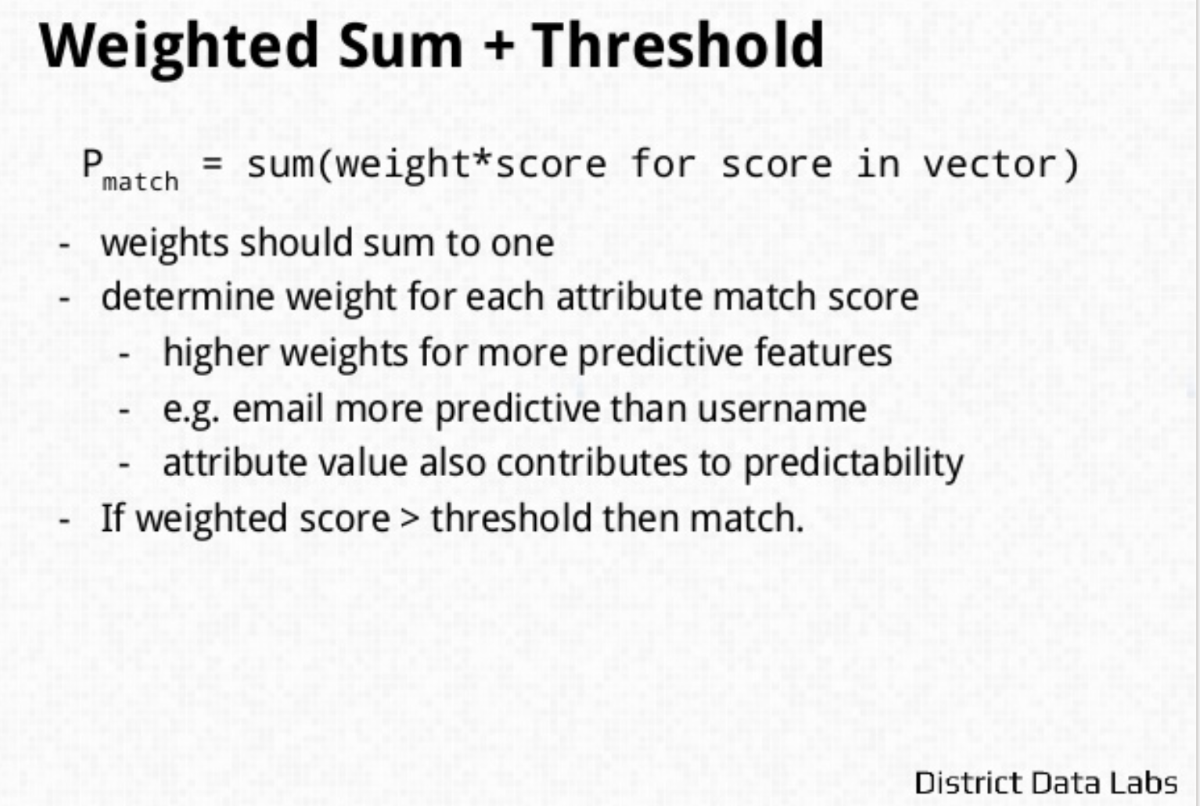

Slide 13
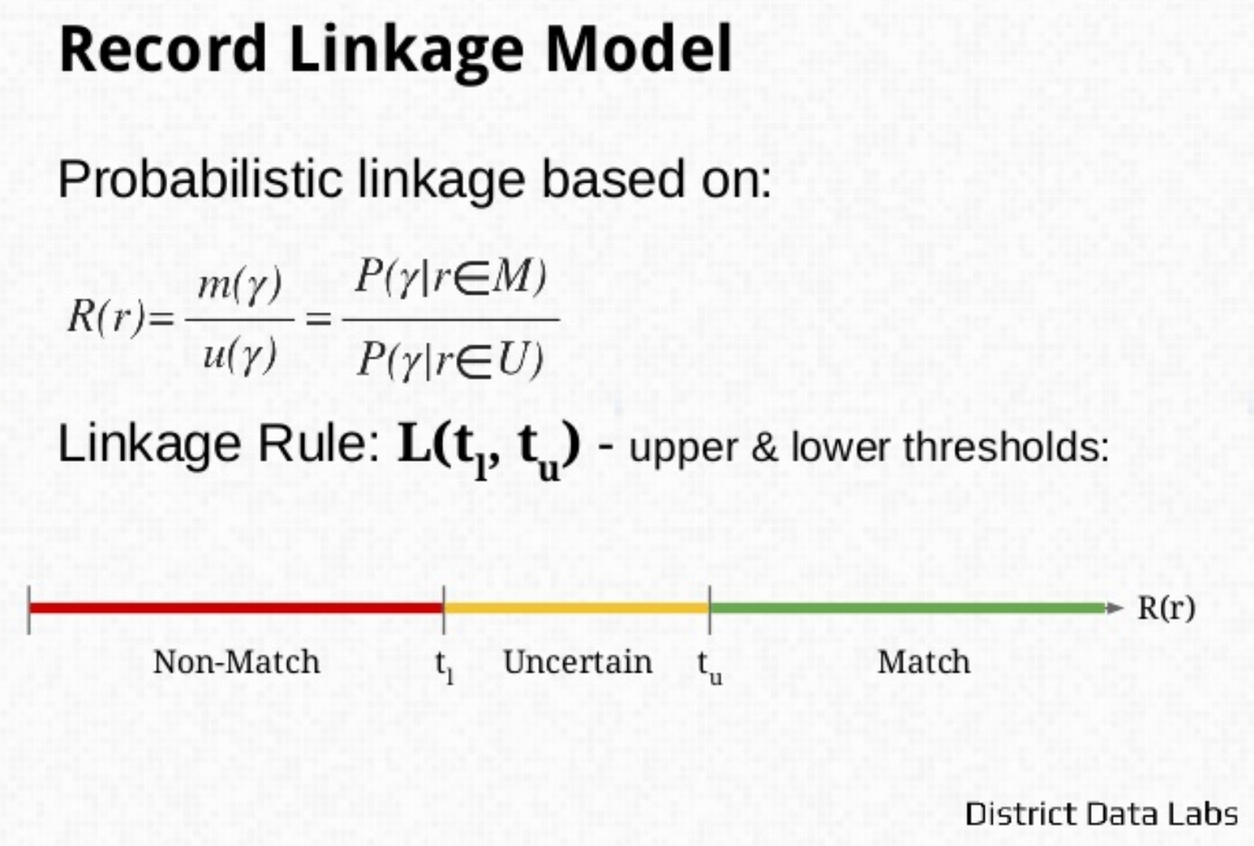

Slide 14
Approach in practice
each matching variable is compared and assigned a score (weight) based on how well it matches
frequency analysis of data values is important
uncommon value agreement stronger evidence for linkage (e.g. Anastasia vs. John)
calculates a score for each field that indicates, for any pair of records, how likely it is that they both refer to the same entity
sum the scores over fields
sort record pairs in order of their scores (weights)
BLOCKING really critical

Slide 15
Probabilistic Record Linkage
Basic idea by Newcombe & Kennedy (1962), Theory Fellegi & Sunter (1969)
Allows wider range of potential identifiers
Computing weights based on estimated ability to match or not match (frequency ratios)
Unlike rule based method, algorithms can be trained
Problem: Estimating errors and thresholds, independence assumption, clerical review, individual variables not string
Often used:
M-probability: probability that a field agrees given that the pair of records is a true match
U-probability: probability that a field agrees given that the pair of records is NOT a true match
U probability for birth month 1/12 appx. 0.083

Slide 16
U and M probability in words
The u probability is the probability that an identifier in two non-matching records will agree purely by chance – this is determined by relative frequency in the data (e.g. for birth month, approximately 1/12)
The m probability is probability that an identifier in matching pairs will agree

Slide 17
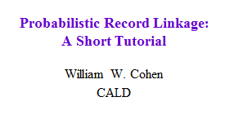
Felligini-Sunter: notation
Two sets to link: A and B
A x B = {(a,b) : a ϵ A, b ϵ B} = M U U
M = matched pairs, U= unmatched pairs
Record for a ϵ A is α(a), for b ϵ B is β(b)
Comparison vector, written γ(a,b), contains “comparison features” (e.g., “last names are same”, “birthdates are same year”, …)
γ(a,b)=f( γ¹(α(a),β(b)),…, γ^{K}(α(a),β(b))
Comparison space Γ = range of γ(a,b)

Slide 18
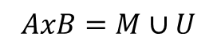
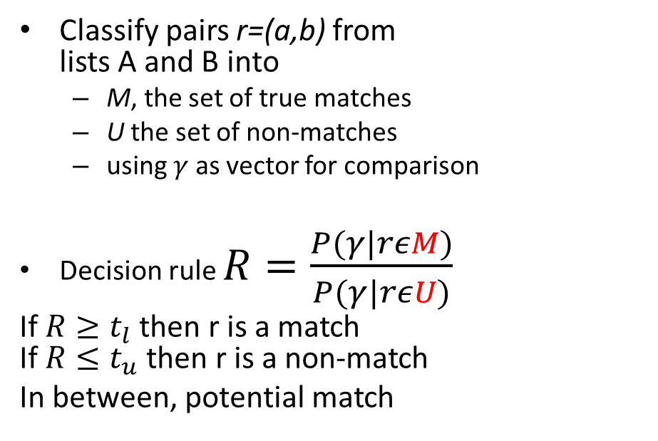
Felligi & Sunter
Classify pairs r=(a,b) from lists A and B into
M, the set of true matches
U the set of non-matches
using $γ$ as vector for comparison
Decision rule $R=\frac{P(γ|rεM)}{P(γ|rεU)}$
If $R≥t_{l}$ then r is a match If $R≤t_{u}$ then r is a non-match
In between, potential match
B
A
M
U
$$AxB=M∪U$$

Slide 19
Felligini-Sunter: notation
Three actions on r(a,b):
A₁: treat (a,b) as a match
A₂: treat (a,b) as uncertain
A₃: treat (a,b) as a non-match
A linkage rule is a function
L: Γ ! {A₁,A₂,A₃}
Assume a distribution D over A x B:
m(γ) = Pr_{D}( γ(a,b) | (a,b) ϵ M )
u(γ) = Pr_{D}( γ(a,b) | (a,b) ϵ U )

Slide 20
Felligini-Sunter: main result
Suppose we sort all γ’s by m(γ)/u(γ), and pick n< n’ so
Then the best* linkage rule with Pr(A₁|U)=μ and Pr(A₃|M)=λ is:
γ₁…,γ_{n}, γ_{n+1},…,γ_{n’-1},γ_{n’},…,γ_{N}
m(γ)/u(γ) large
m(γ)/u(γ) small
A₁
A₂
A₃
*Best = minimal Pr(A₂)

Slide 21
Main issues in F-S model
Modeling and training:
How do we estimate m(γ), u(γ) ?
Making decisions with the model:
How do we set the thresholds?
Feature engineering:
What should the comparison space Γ be?
Distance metrics for text fields
Normalizing/parsing text fields
Efficiency issues:
How do we avoid looking at |A| * |B| pairs?

Slide 22
Conditional Independence Assumption
Given a pair of records representing the same entity (true match), we assume that agreement in each field is independent of agreement in other fields
CIA is a mathematical convenience only
In reality, record fields won’t be conditionally independent. Improve match discrimination by eliminating covarying fields (more fields not always better matching)
Area codes covary with geography
First name and last name may be correlated (e.g. Asian names)

Slide 23
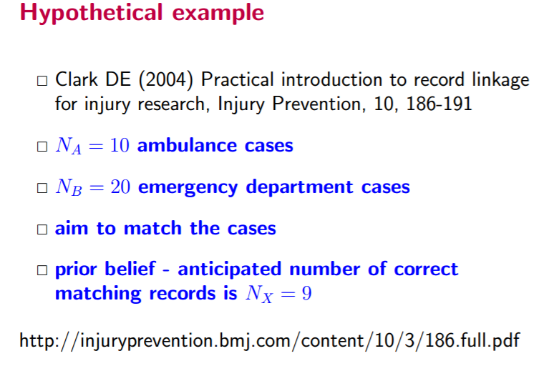
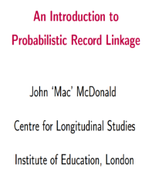

Slide 24
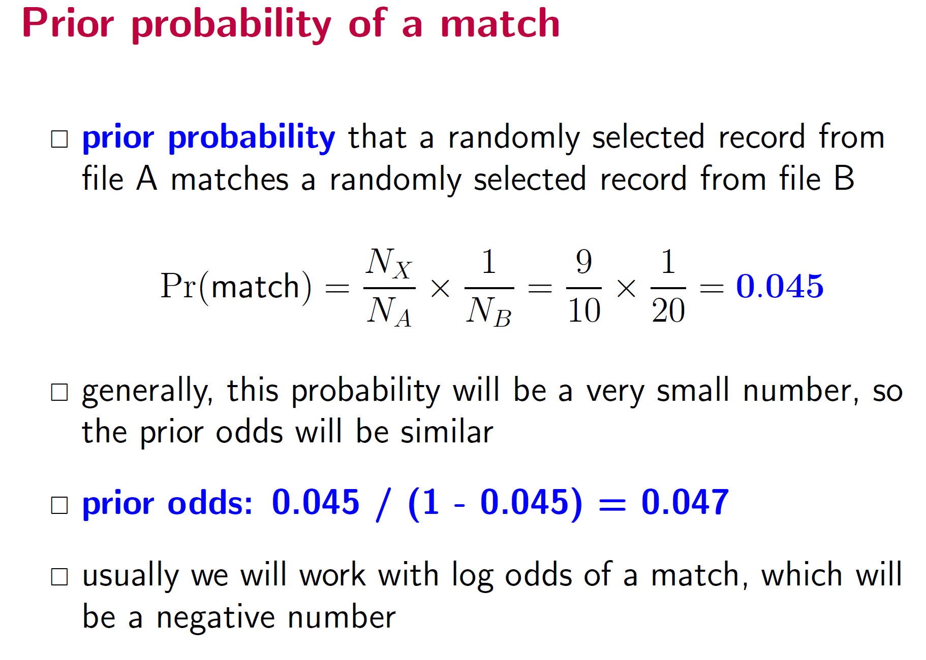

Slide 25
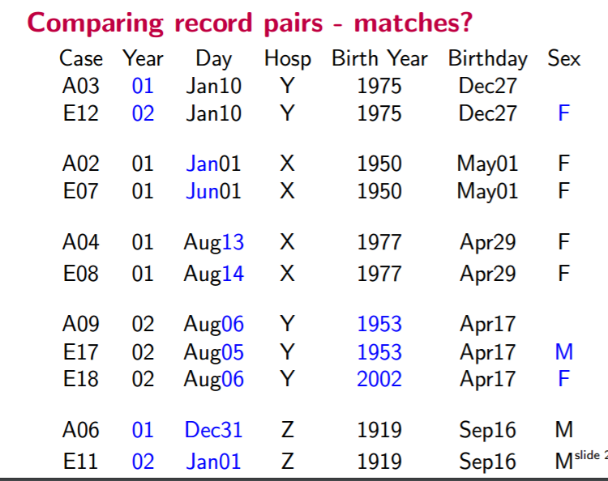
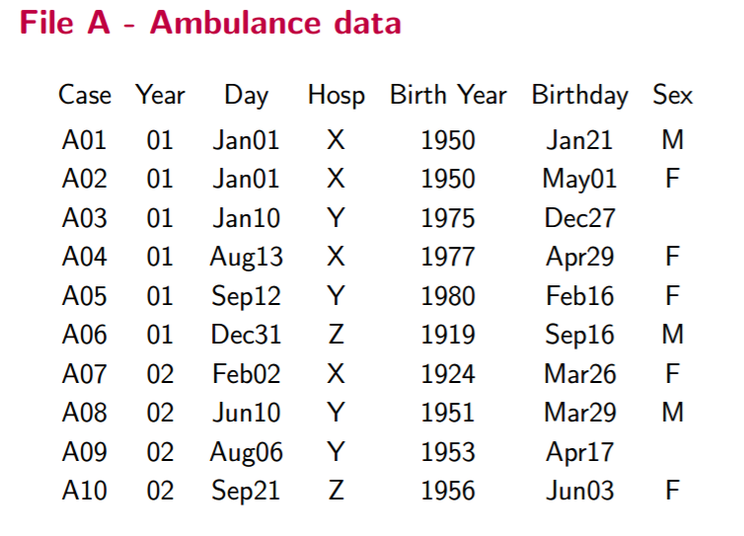
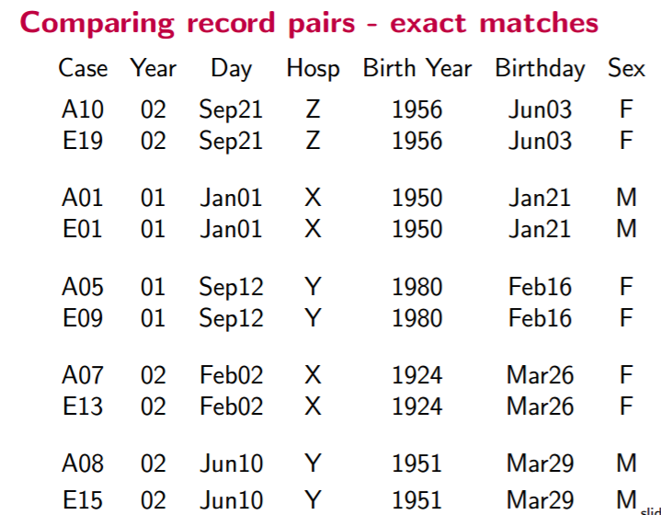
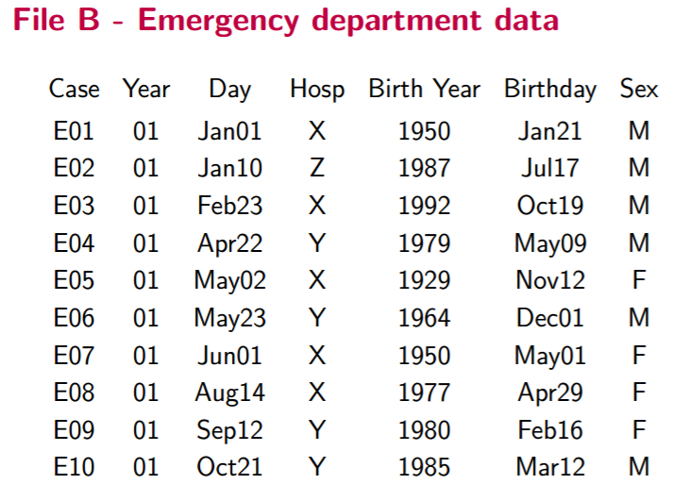

Slide 26
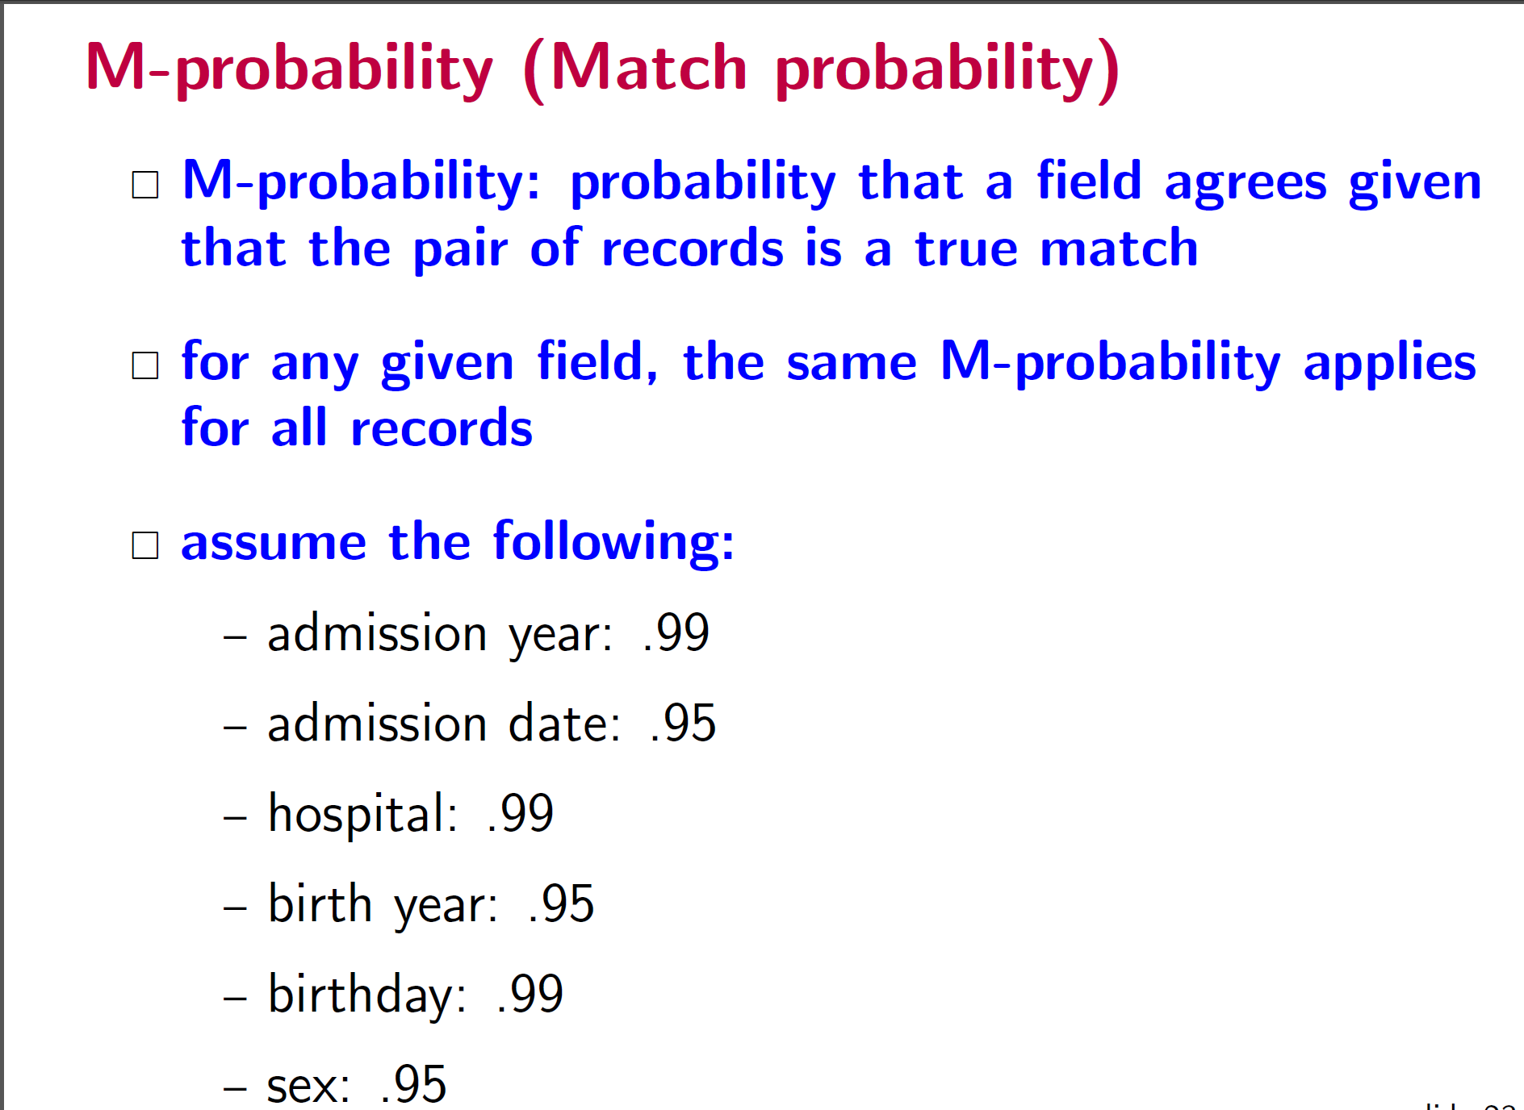

Slide 27
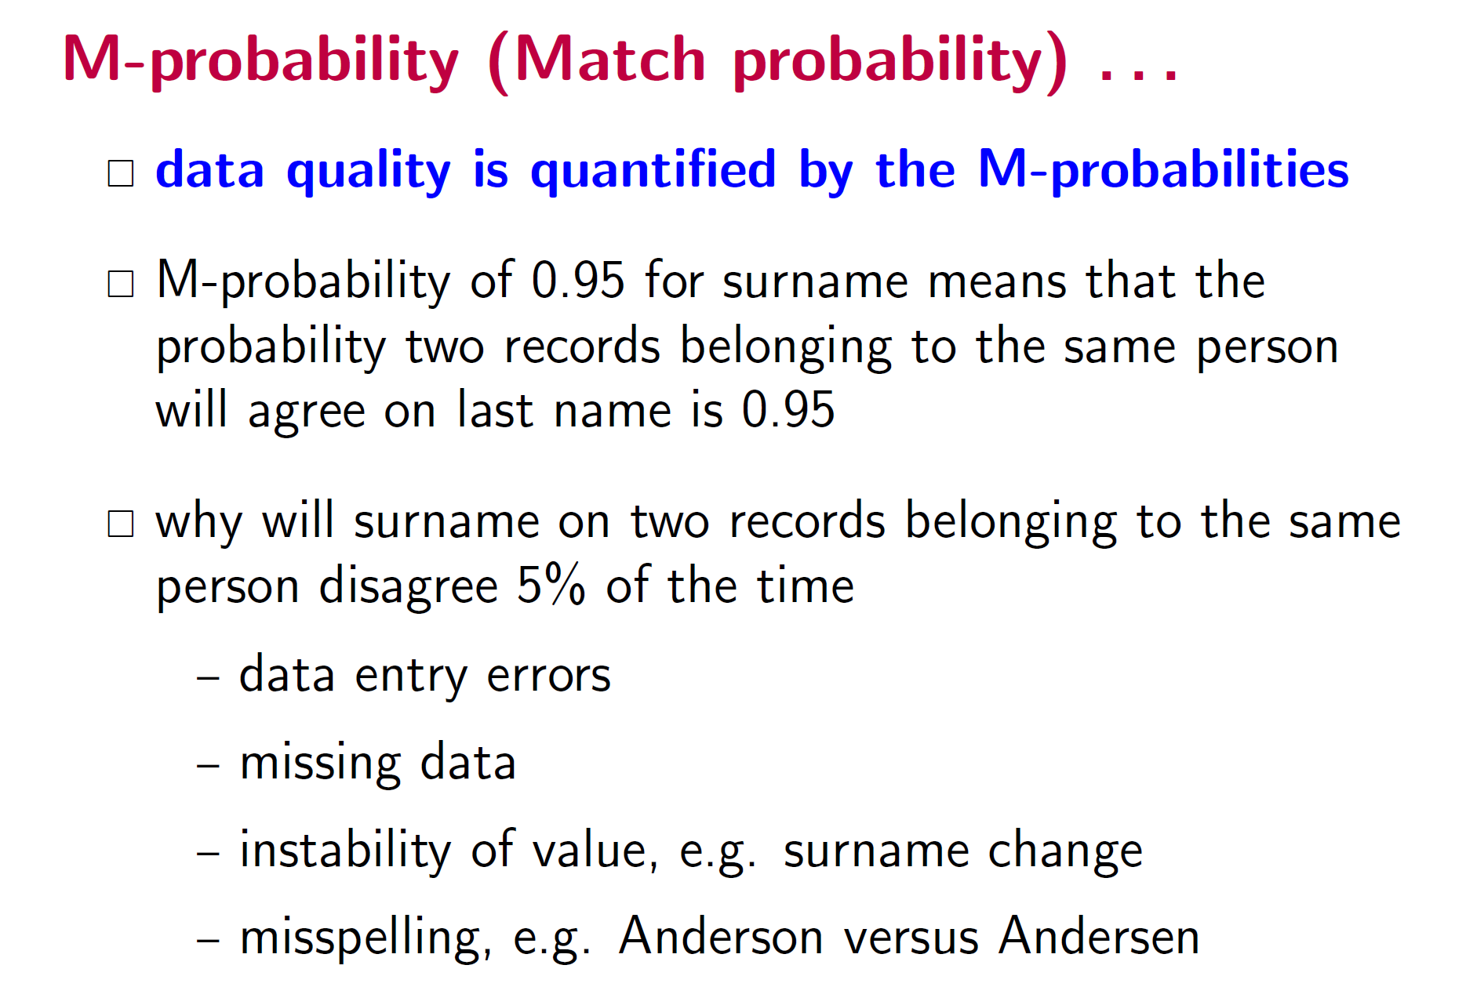

Slide 29
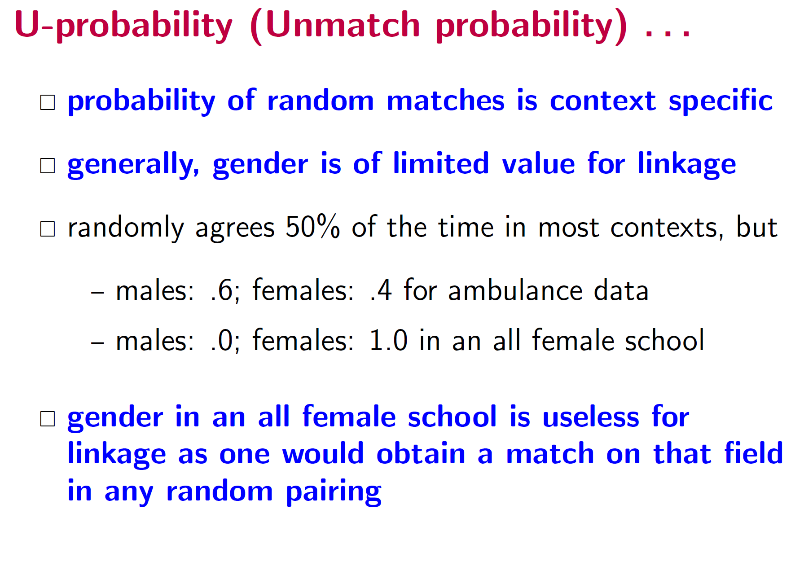

Slide 33
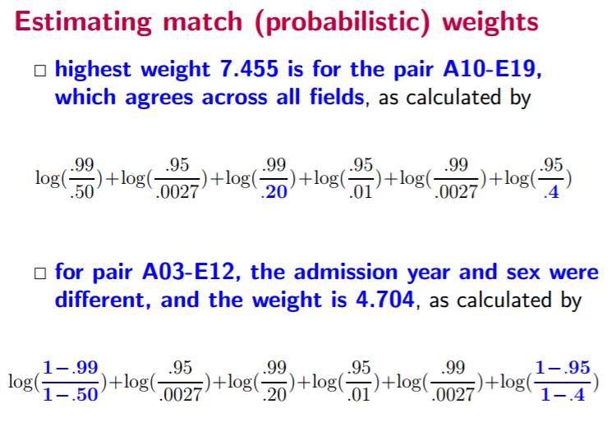

Slide 35
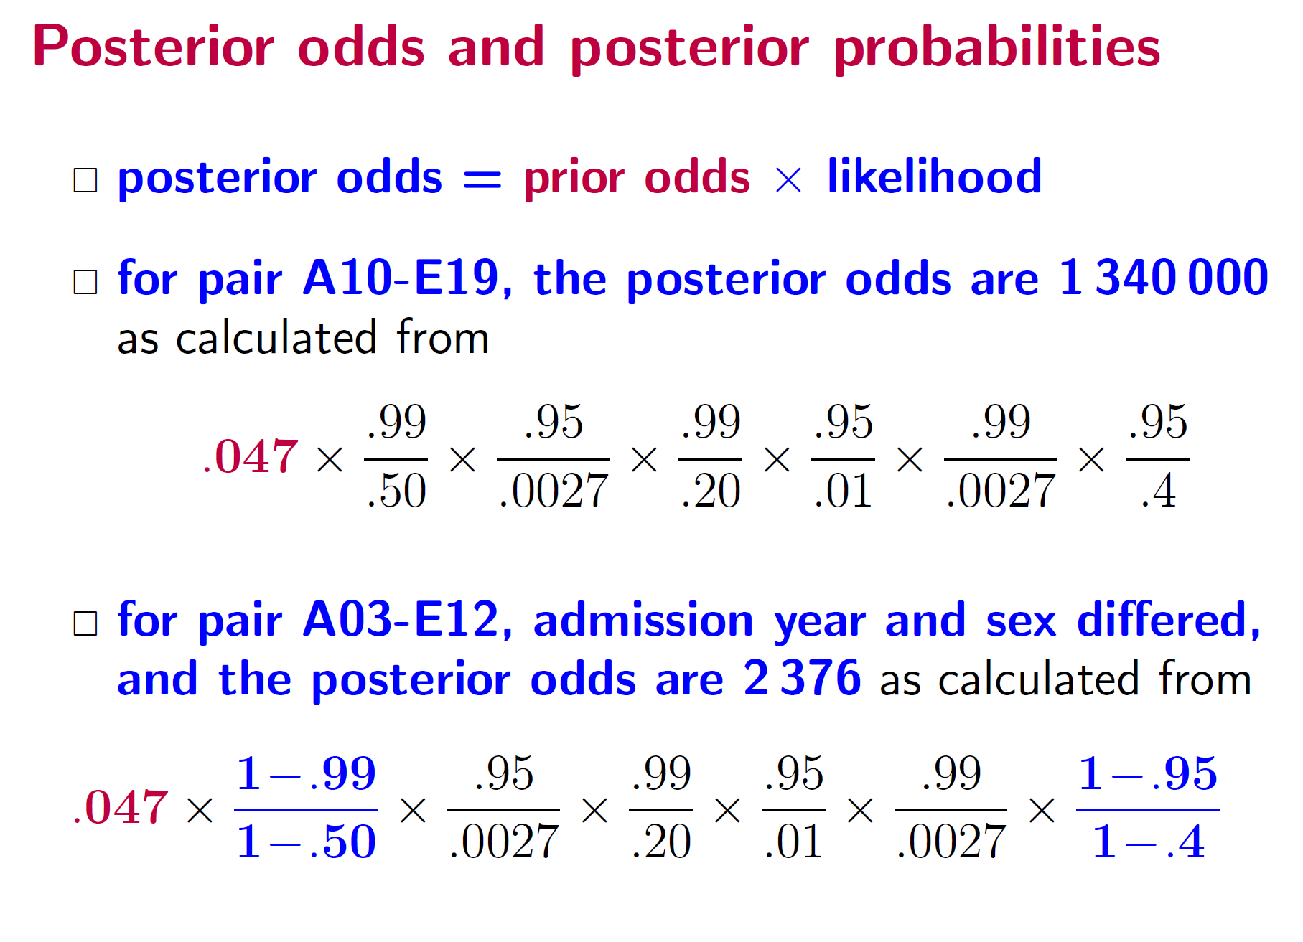

Slide 36
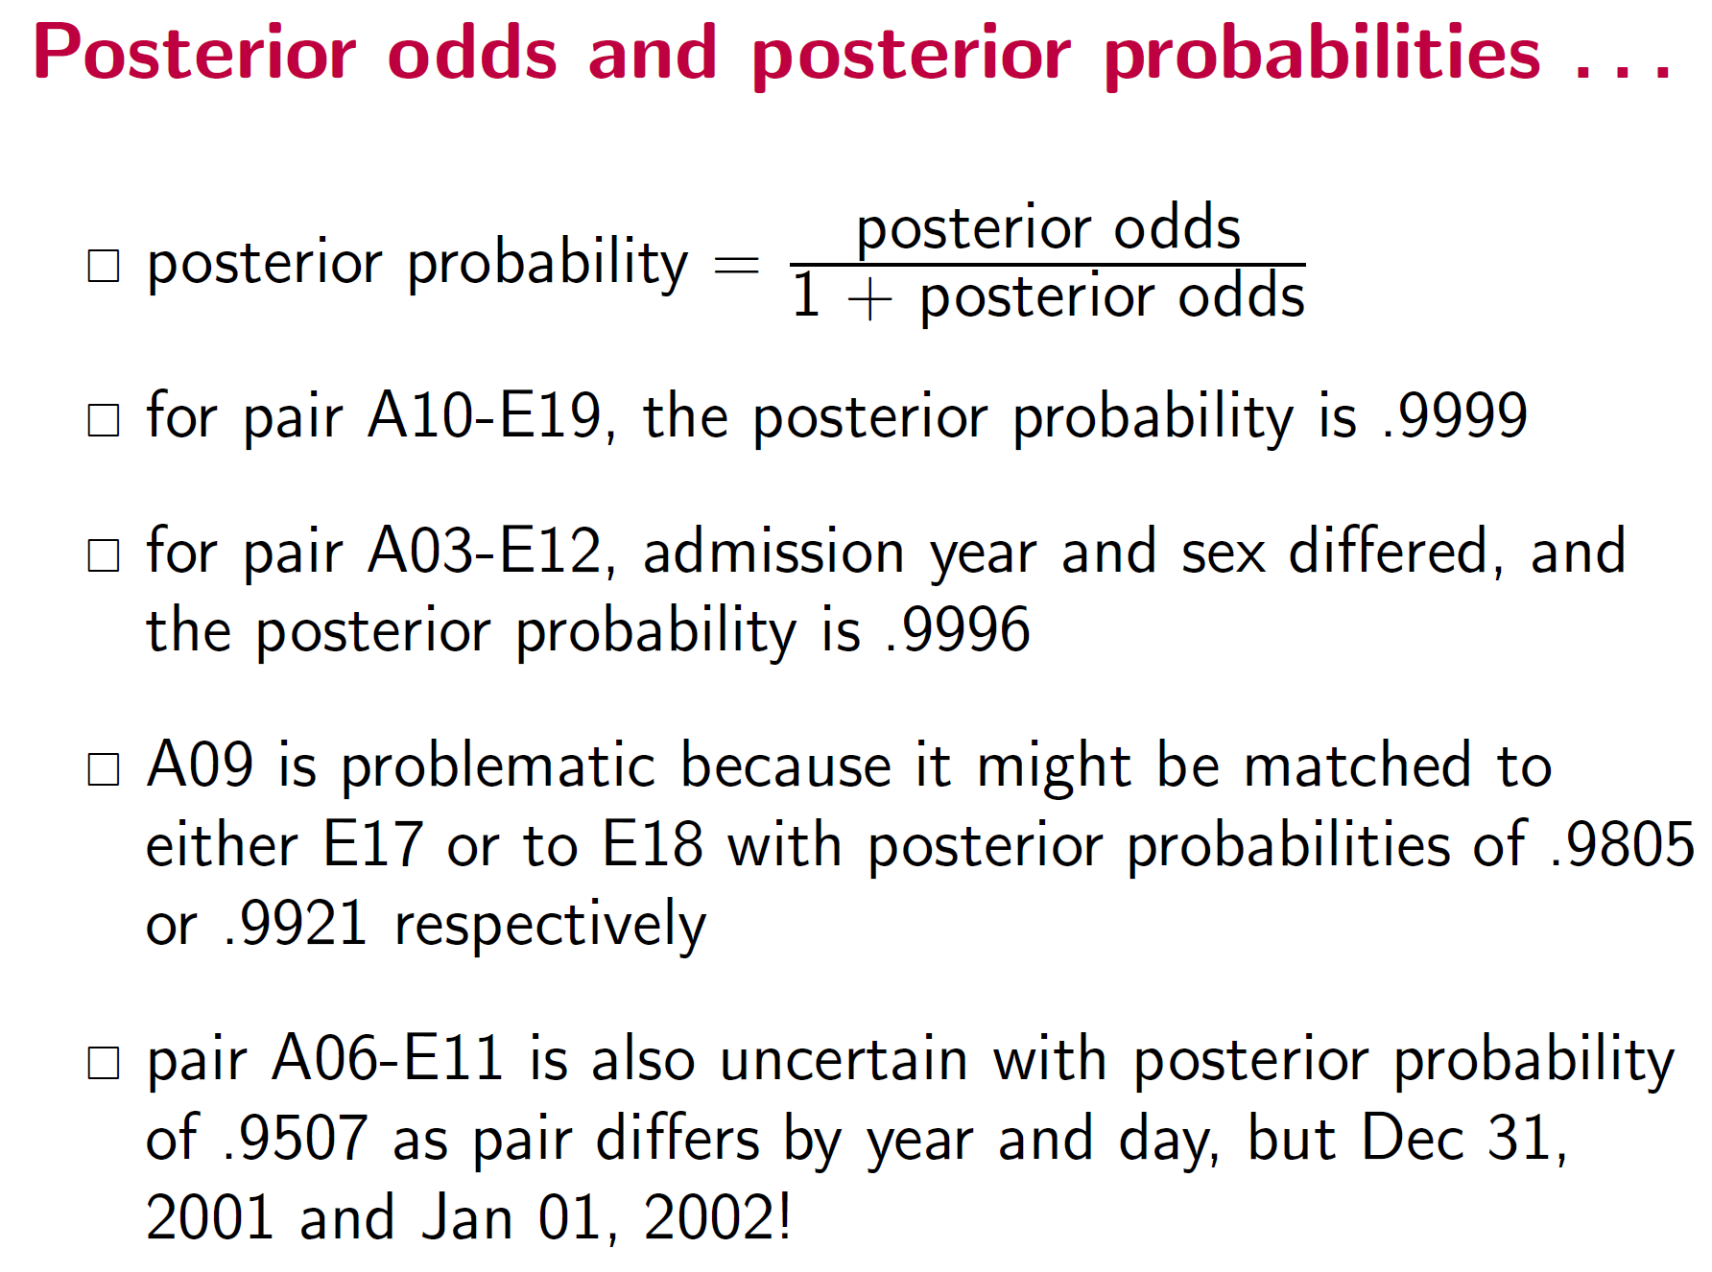

Slide 37
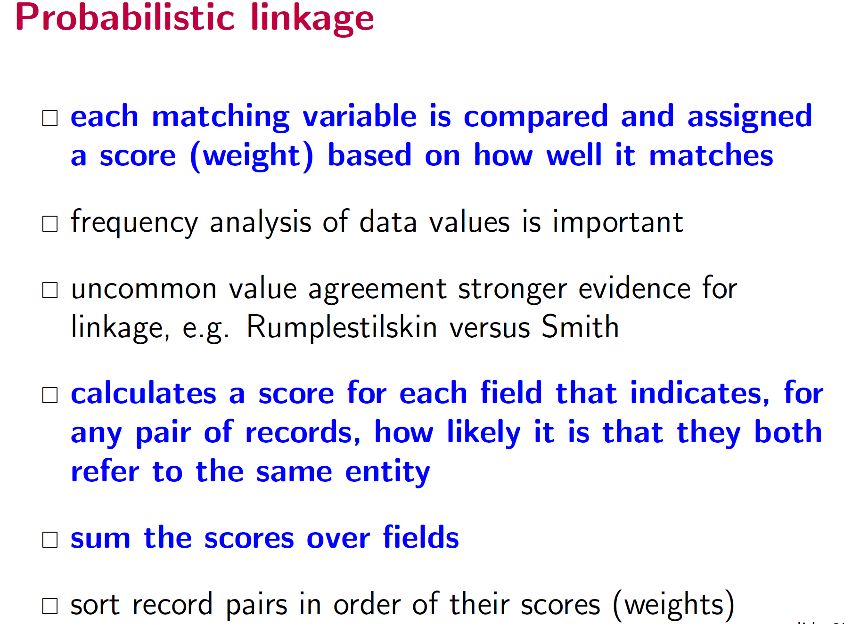

Slide 38
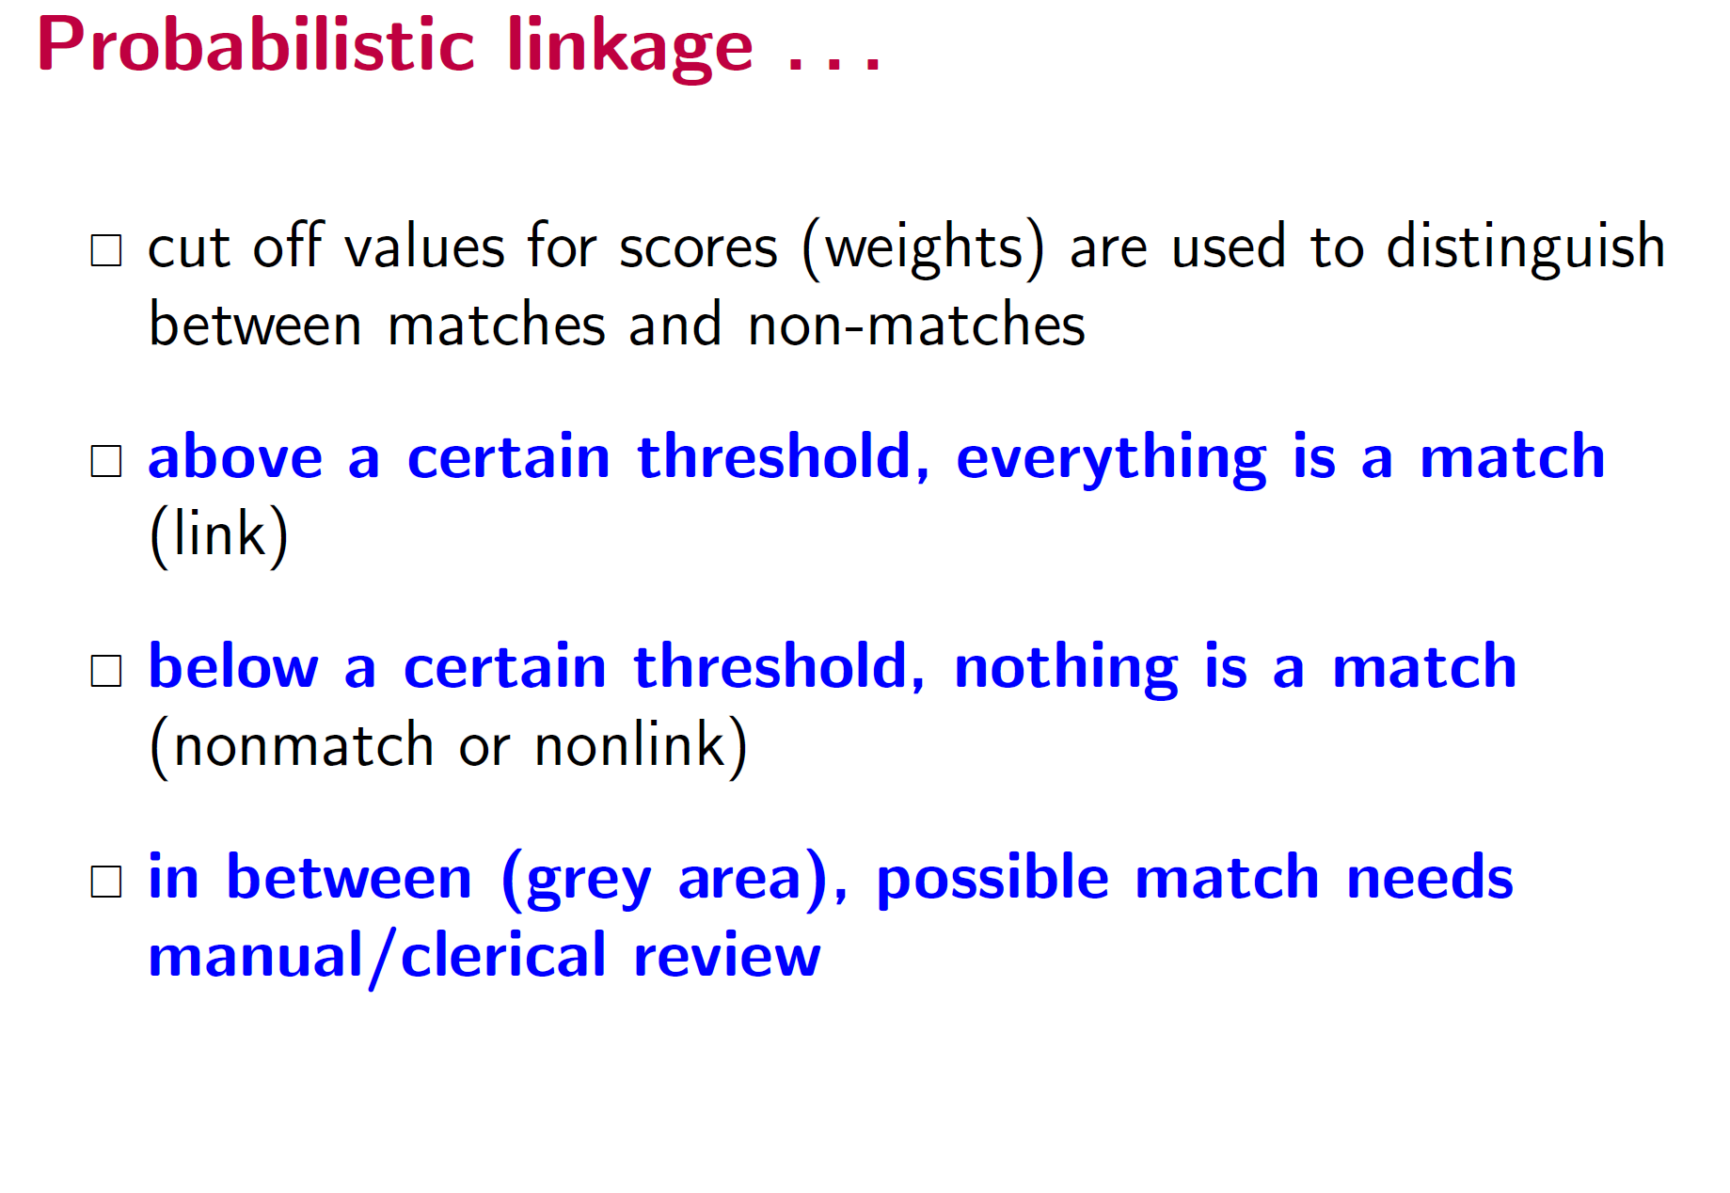

Slide 39
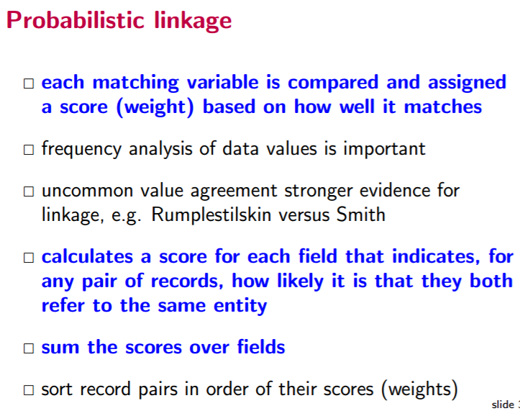
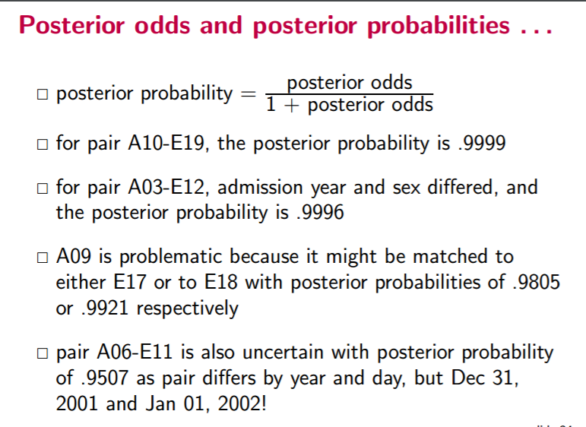
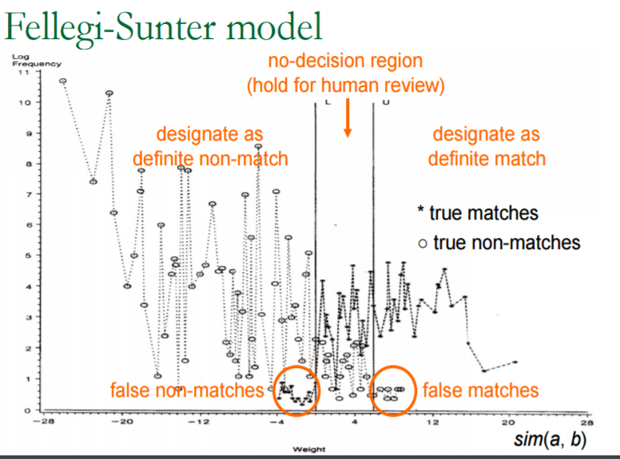

Slide 40
Overview
Why link records?
Preprocessing
Blocking/Indexing
Linkage approaches
Rule based
Probabilistic
“Computer Science”
Evaluation
Challenges

Slide 41
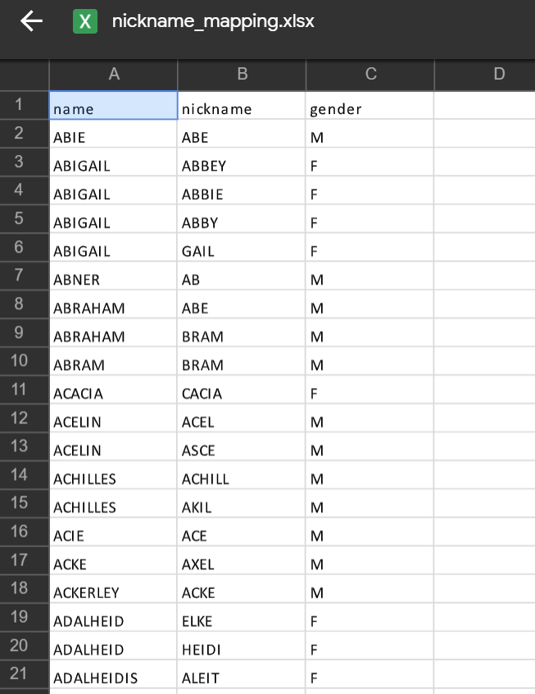

Slide 42
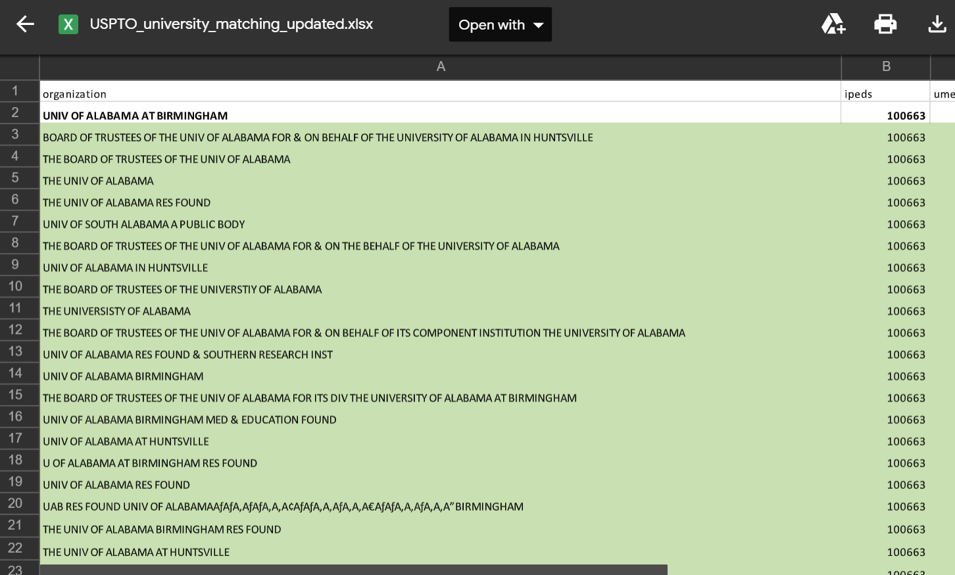

Slide 43
There is no perfect world
In a perfect world
But we do not live in a perfect world
Predicted
True Positive (TP)
 | True Negative (TN)
True
Predicted
True Positive (TP) | False Negative (FN)
False Positive (FP) | True Negative (TN)
True

Slide 44
Evaluation
Predictions are often scores between 0 and 1
We need to first turn them into 0 or 1 by selecting a threshold
Accuracy = (TP + TN) / (TP + TN + FP + FN)
Precision (or PPV) = TP / (TP + FP)
Recall (or Sensitivity) = TP / (TP + FN)
Specificity = TN / (TN + FN)

Slide 45
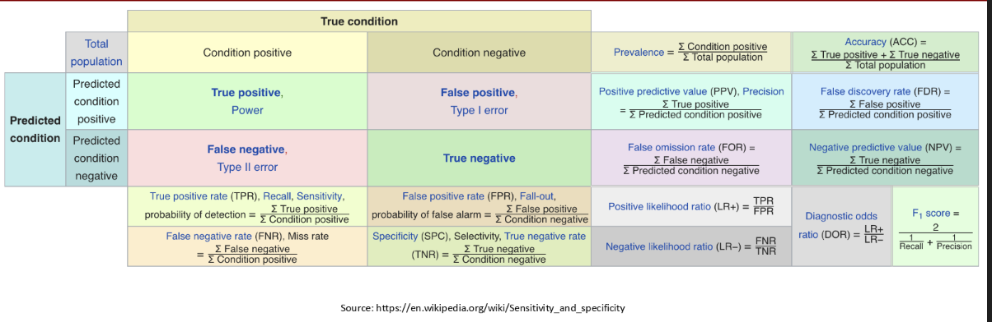
Metric Cheatsheet

Slide 46
Note
If focus is true cases, then investigators may want to focus on sensitivity.
If focus is minimize false positives, the researcher may focus on specificity.

Slide 47
Other measures
Note that most of comparison space is true non matches (e.g., specificity and NPV)
F-Measure is ((β² + 1.0) * Sensitivity * PPV) / (β² * Sensitivity + PPV)
Harmonic mean β is equal to the user-assigned relative importance of sensitivity over PPV.

Slide 48
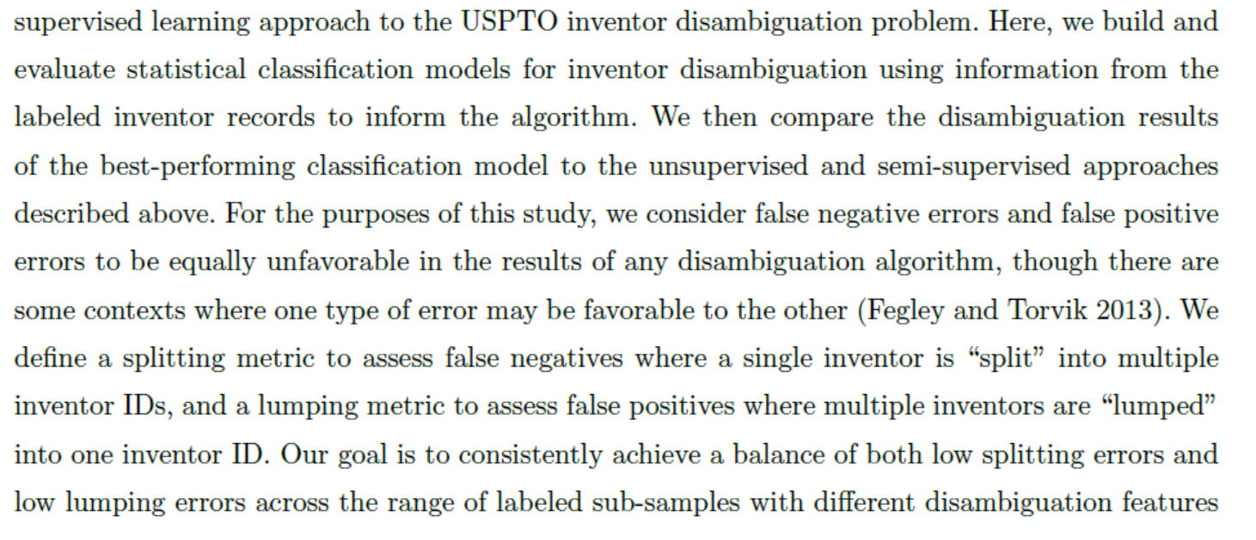
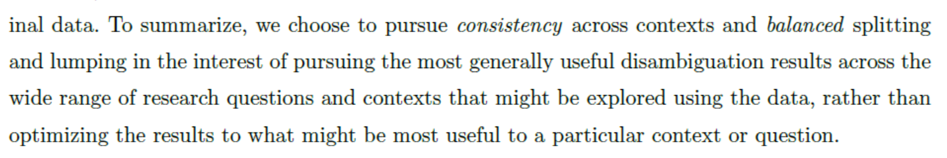
Seeing the Non-Stars: (Some) sources of bias in past disambiguation approaches and a new public tool leveraging labeled records

Slide 49
Overview
Why link records?
Preprocessing
Blocking/Indexing
Linkage approaches
Rule based
Probabilistic
“Computer Science”
Evaluation
Challenges

Slide 50
Summary: Record Linkage Technique (Christen 2015)
Deterministic matching
Rule-based matching (complex to build and maintain)
Probabilistic record linkage (Fellegi and Sunter, 1969)
Use available attributes for linking (often personal information, like names, addresses, dates of birth, etc.)
Calculate match weights for attributes
“Computer science” approaches
Based on machine learning, data mining, database, or information retrieval techniques

Slide 51
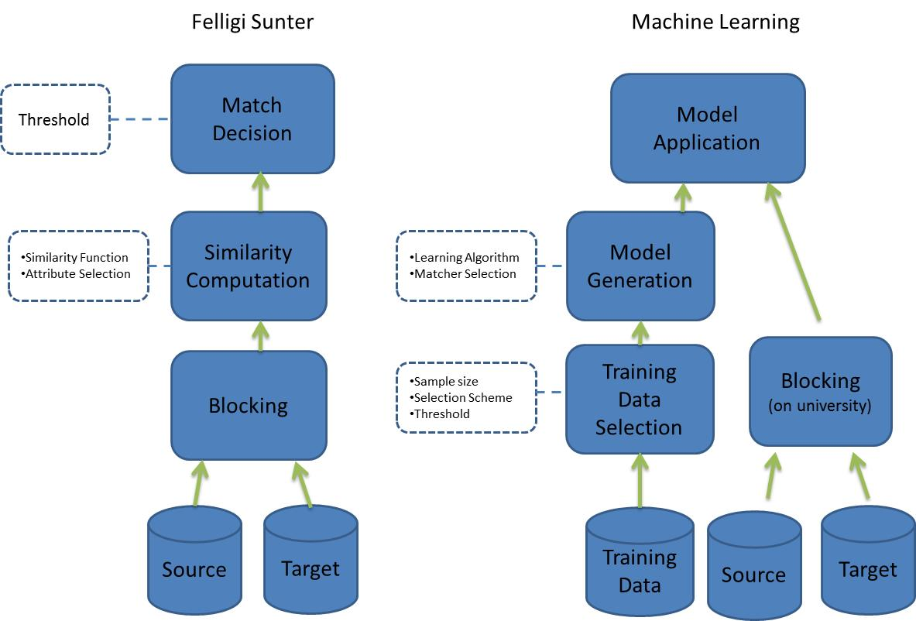
Approaches to linking: Probabilistic vs Machine Learning

Slide 52
Summary: Challenges (Christen 2012)
Scalability
Naïve comparison of all record pairs is quadratic
Remove likely no-matches as efficiently as possible
Need efficient etchniques
More linked / multi-relational
Need to infer relationship
No training data in many linkage applications
No record pairs with known true match status

Slide 53
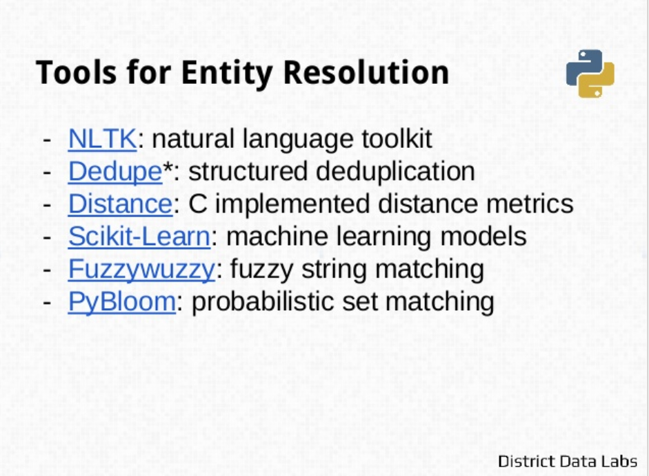
Tools

Slide 54
And reminder of why we care

